Slide 1
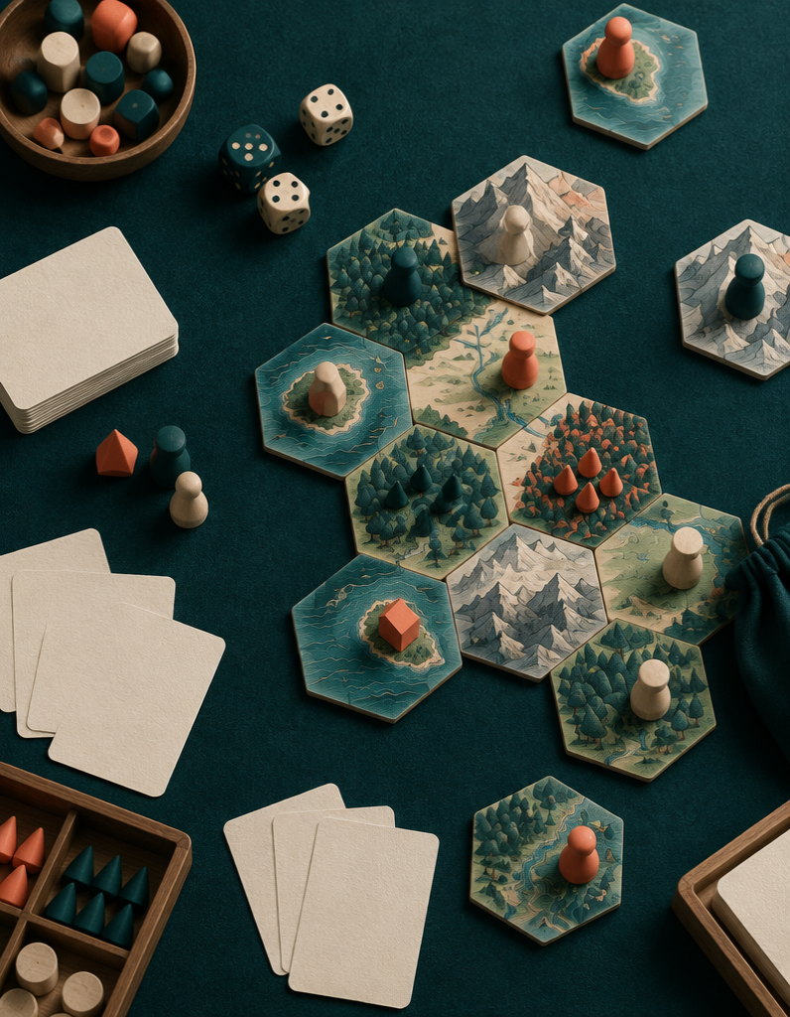
BOARDGAMEGEEK ARTISTS DATASET
Who Draws
Board Games?
An exploratory analysis of 21,925 games × 1,678 named artists
ONE-HOT MATRIX • CREDITS • COLLABORATIONS
BGG ARTISTS / EXPLORATORY ANALYSIS
01

Slide 2
01 / STRUCTURE
The data is a binary map
One row per game (BGGId). One 0/1 column per named artist. A 1 means that artist is credited on that game.
0 0 0 1 0 0 0 0 1 0 0
21,925
1,678
Each row is mostly zero.
GAME ROWS
ARTIST COLUMNS
BGG ARTISTS / EXPLORATORY ANALYSIS
02

Slide 3
02 / FIRST PASS
Clean — but extremely sparse
The matrix is structurally simple and analysis-ready. Its defining feature is absence: nearly every artist–game cell is zero.
CLEAN
SPARSE
Stable row key
Binary artist columns
Wide matrix
Very low density
BGG ARTISTS / EXPLORATORY ANALYSIS
03

Slide 4
03 / COVERAGE
Which games credit an artist?
Coverage is a row-level question: sum each game’s artist columns, then count rows above zero. The supplied summary does not report that final count — so it should be computed, not guessed.
18,816
coverage = mean(row sum > 0)
TOTAL ARTIST CREDITS
Report both: games with ≥1 named artist, and games with zero named artists.
BGG ARTISTS / EXPLORATORY ANALYSIS
04

Slide 5
04 / DISTRIBUTION
Usually one artist. Occasionally many.
The modal experience is a single named artist. A thin tail of multi-artist games creates the collaboration network.
1 artist
1
2
3
4
MOST COMMON
5+
BGG ARTISTS / EXPLORATORY ANALYSIS
05

Slide 6
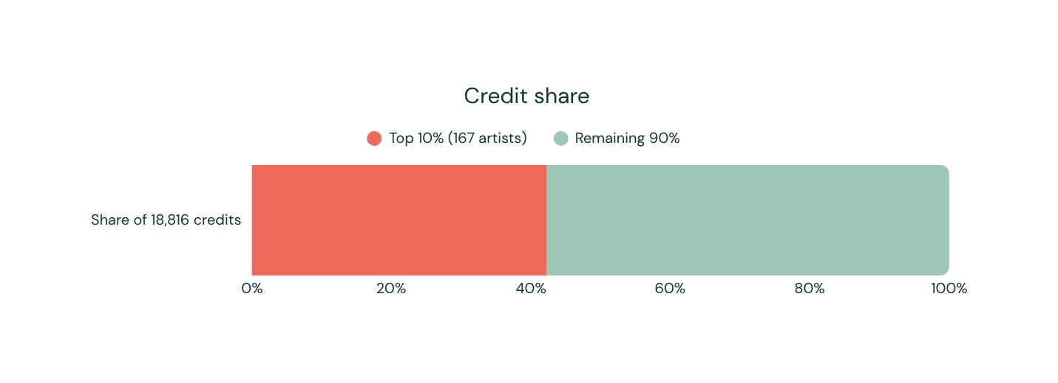
05 / CONCENTRATION
A few artists dominate
6
11.2
379
Gini 0.48
MEDIAN GAMES
MEAN GAMES
MAX GAMES
703 artists have only 4–5 games. Just 14 have 100+.
BGG ARTISTS / EXPLORATORY ANALYSIS
06

Slide 7
06 / COLLABORATION
Partnerships form a long tail
25,413 artist pairs share at least one game. Only 69 pairs share 10 or more.
25,413
7
140
CONNECTED PAIRS
MEDIAN COLLABORATORS
SOLO-ONLY ARTISTS
BGG ARTISTS / EXPLORATORY ANALYSIS
07

Slide 8
07 / PROXY FOR TIME
BGGId thirds approximate eras
IDs were assigned roughly in order of addition. Splitting the ordered IDs into thirds offers a useful exploratory proxy — not a publication-date timeline.
EARLY
MIDDLE
RECENT
Established catalogs
Expanding credits
More one-off artists
Use metadata joins to test this properly by release year.
BGG ARTISTS / EXPLORATORY ANALYSIS
08

Slide 9
08 / NEXT QUESTIONS
Join the matrix to meaning
The artist matrix becomes far more valuable when connected to game metadata.
01
02
03
Genres & mechanisms
Publishers & geography
Careers over time
Which artist communities specialize in wargames, family games, or abstract strategy?
Who repeatedly works with whom — and across which markets?
Measure entry, longevity, one-off work, and durable partnerships.
BGG ARTISTS / EXPLORATORY ANALYSIS
09

Slide 10

09 / READ WITH CARE
Clean matrix.
Uneven creative field.
Credit is concentrated in a small core of prolific artists and long-running partnerships, especially in wargames; newer games appear to rely more on one-off artists.
LIMITATIONS
BGG coverage and credit practices vary. BGGId is only a rough time proxy. Names may contain aliases or homonyms. The matrix alone cannot explain genre, publisher, country, or release year.
Its full value comes from joining it with game metadata.
BGG ARTISTS / EXPLORATORY ANALYSIS
10

